Slide 1
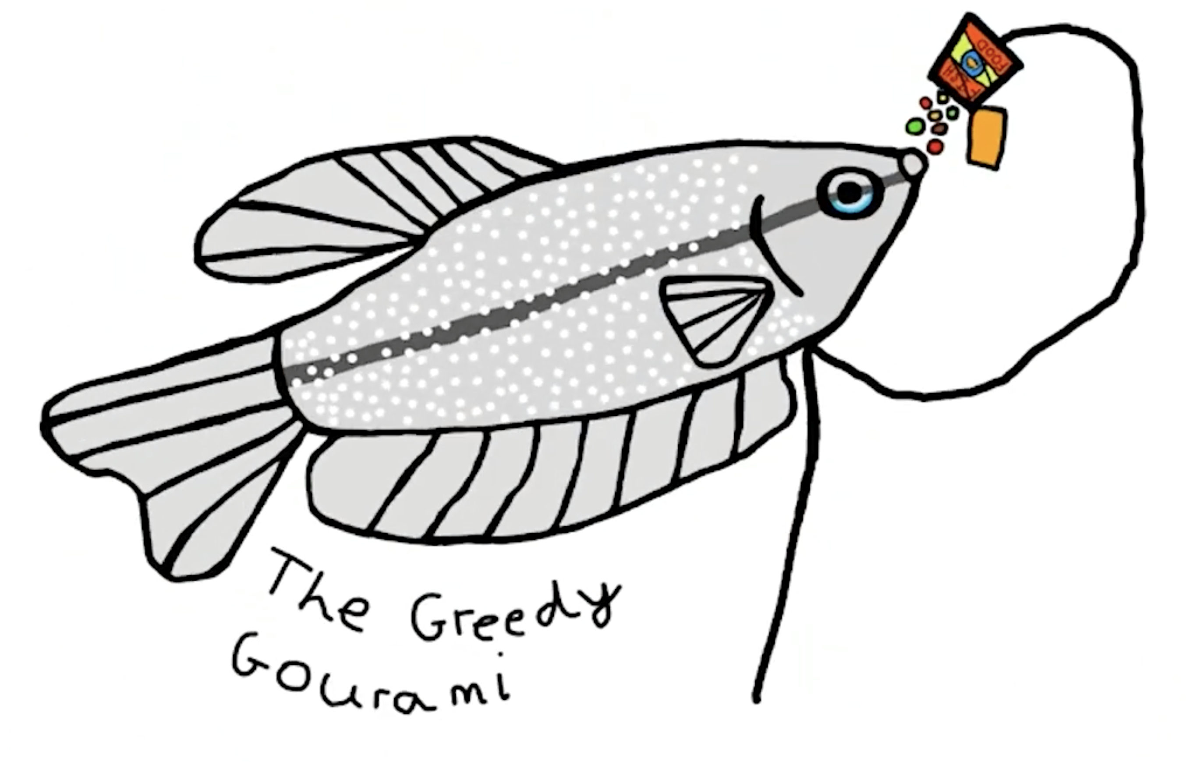

The Greedy Gourami Presents:
A beginner's guide for Pokémon go

Slide 2

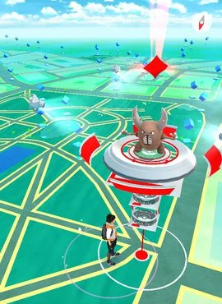
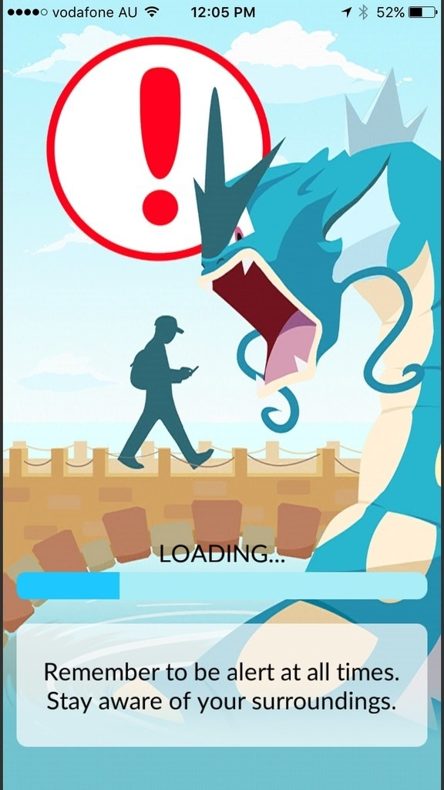
How I first Got Into Pokémon Go
Originally, I set up my Pokémon go account in 2016 but lost interest soon after, sometime later I stated to play it again in 2020.
It had its use for the duke of Edinburgh award as it gave me motivation to get out of the house more.
These days I am very passionate about Pokémon, but I don't really have any spare time to play the main games, so to keep close to the Pokémon games, I decided to keep on playing my pokemon go account.

Slide 3
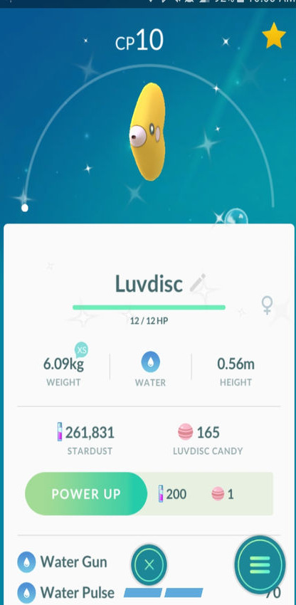


Why I chose this subject
Some of my relatives have said that Pokémon go isn’t very useful and when am I going to grow out of it, so I want to show them that Pokémon go has got a use, passing me through this final project and showing that I have gotten out of the house more often.
I also use Pokémon go for exercise too.

Slide 4
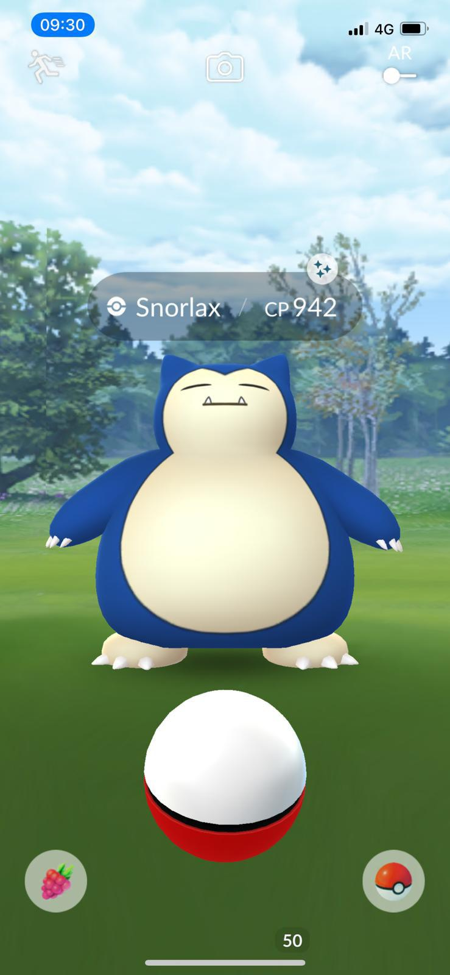
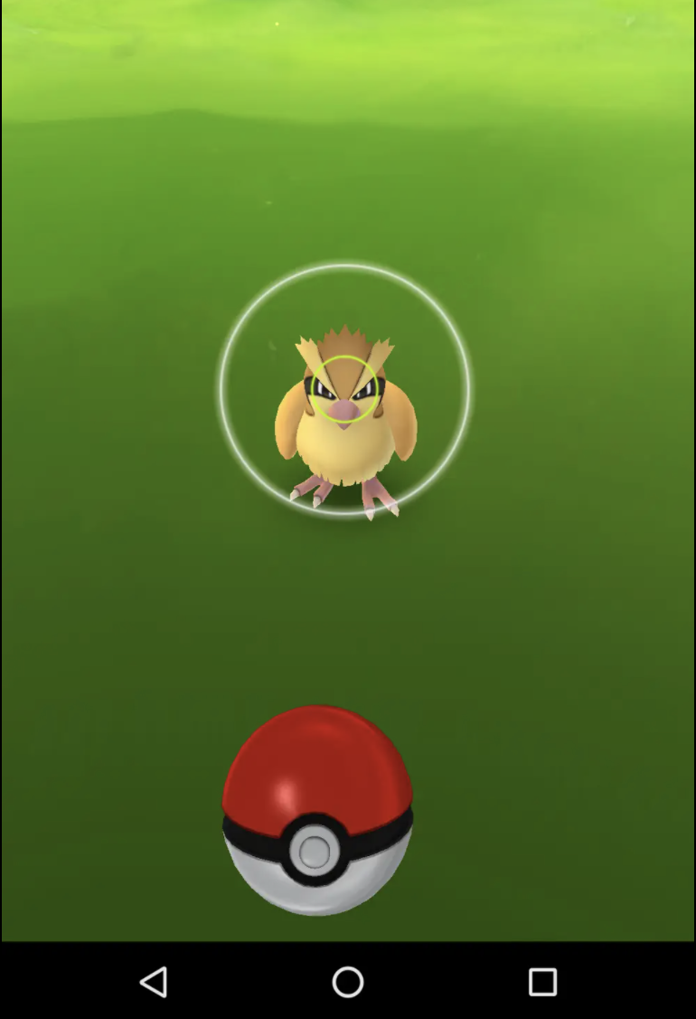

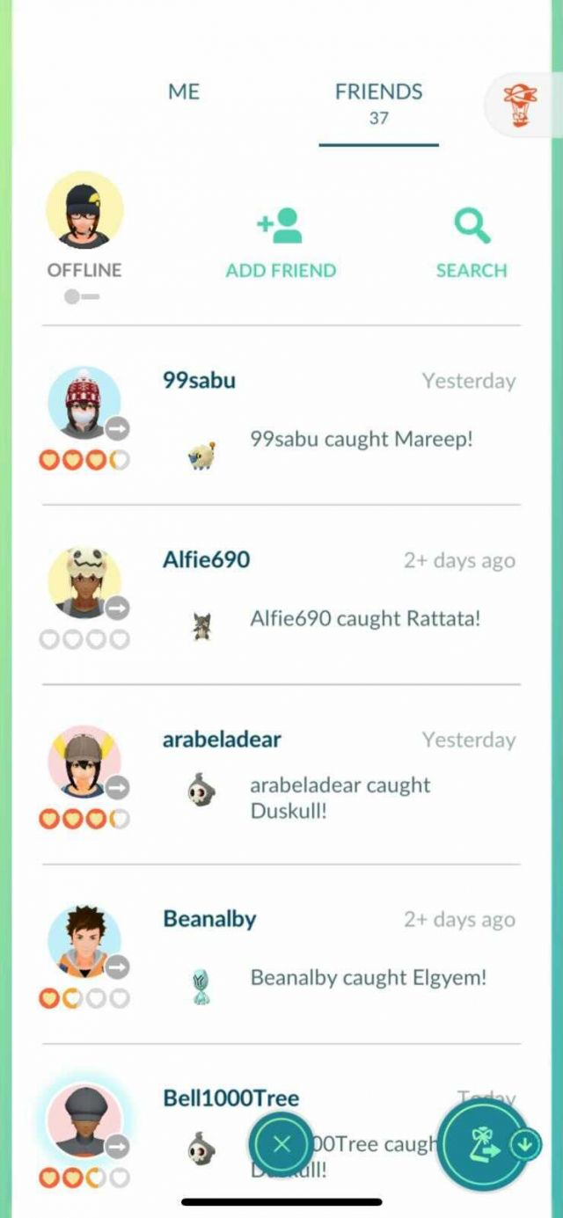
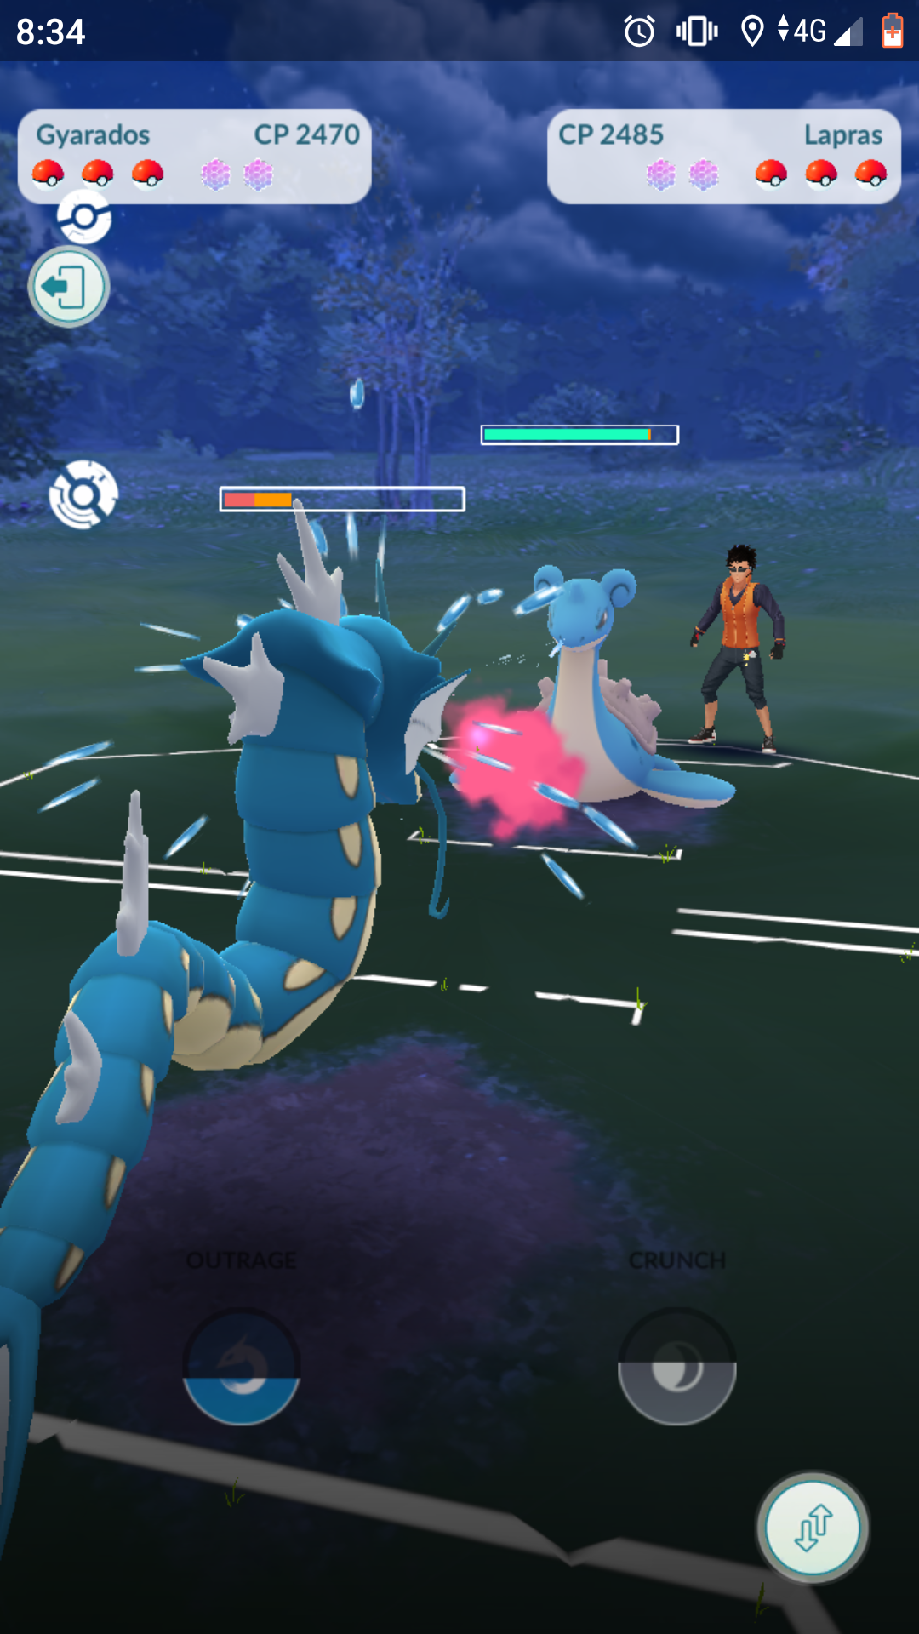
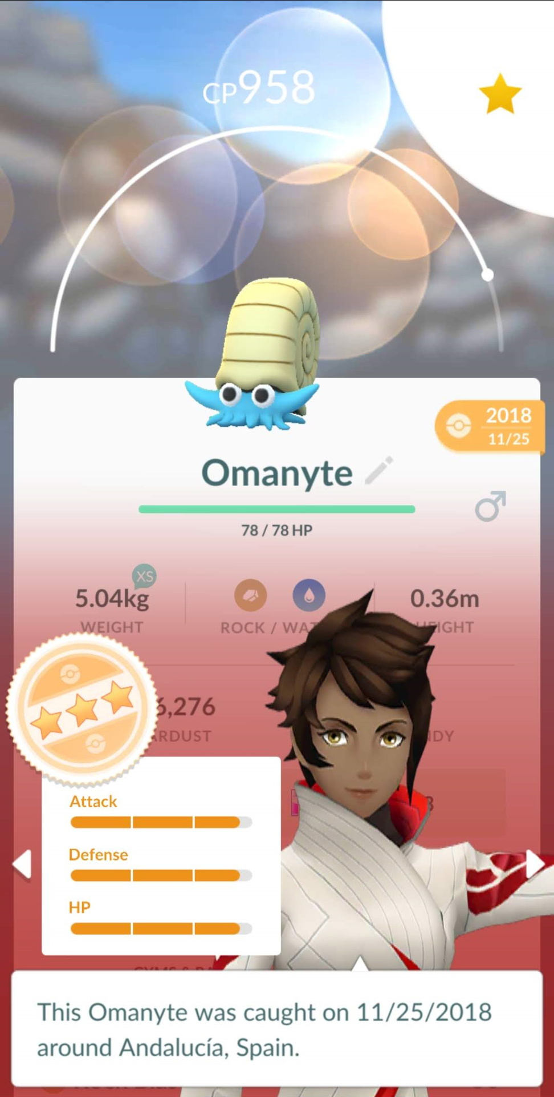
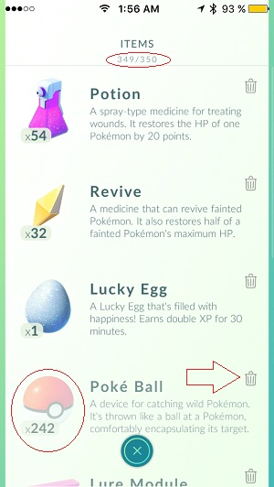

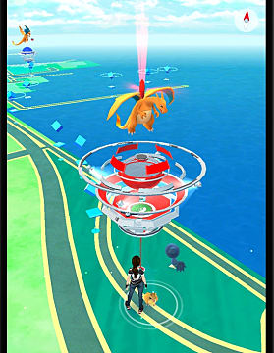
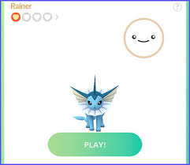
How long it will be
I am planning to making my video the maximum of an hour long, if it is longer than an hour then I will split the video up and upload about 5 smaller videos to keep the attention of my audience.
The list of different elements in pokemon go:
Catching Pokemon
Pokestops/Gyms
Pokemon Summery/IV
Bag
Friends
Battle System Basics
Auto Catchers
Rare Pokemon
Buddy Pokemon

Slide 5



What Genre Might It Be
I feel that my video is going to be in the style of a documentary, however, I do want to incorporate some acting in it to show off some of my skill and show how much I have grown in confidence.
I could make it though in the style of a mockumentary to try and make my video more comedic to my audience.

Slide 6
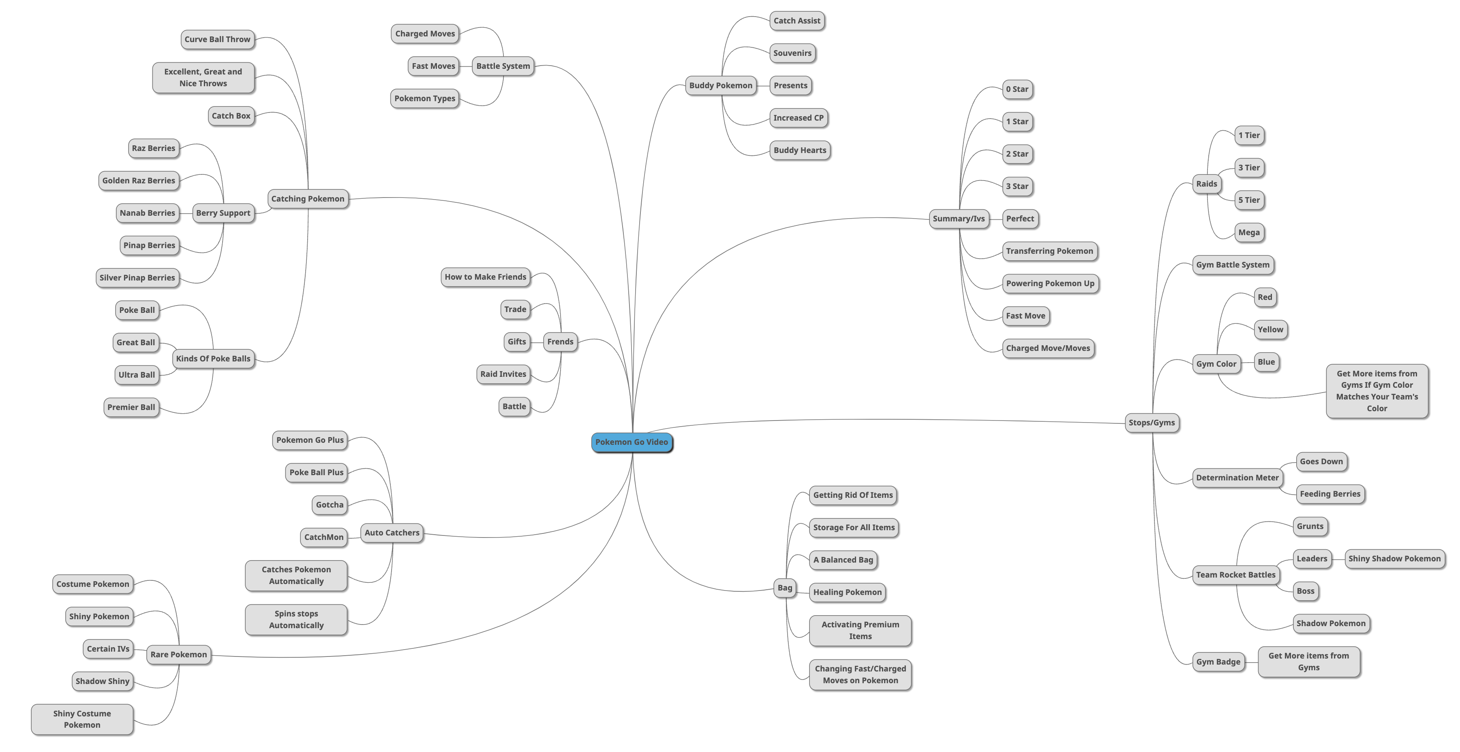
This Mind Map Shows Most Of The Topics That I Will Be Covering For My Video

Slide 7
Thank You For Watching
Feel free to ask me about my video.

